Slide 1



DUAL SOURCE WIRELESS CHARGING SYSTEM FOR ELECTRIC VEHICLES
Presented By
KANISHKA S (927623BEC102)
KANISHKAA S (927623BEC103)
KIRUBA D (927623BEC112)
Guided By
Dr.T.L.Kayathri,M.E.,Ph.D

Slide 2
Problem Statement
Electric vehicles need frequent charging, but wired charging is slow, inconvenient, and requires a physical plug.Misalignment, charging delays, and dependency on a single power source reduce efficiency.There is a need for a continuously available, reliable, and user-friendly charging method.A dual-source wireless charger can solve these issues by providing stable power from two inputs.

Slide 3
Existing System
Conventional EV charging uses wired plug-in chargers.
These systems suffer from:
Plug damage and wiring issues
Inconvenience for users
Only one power source
Wireless systems exist but:
Provide low efficiency
Fail if there is misalignment
Work with only one power supply

Slide 4
Proposed System
A dual-source wireless charging setup using solar power and grid power.
System automatically switches between sources for continuous charging.
Uses inductive wireless power transfer between transmitter and receiver coils.
Provides safe, efficient, and contactless charging for electric vehicles.

Slide 5
Objectives & Scope of the Project
Electric vehicles need frequent charging, but wired charging is slow, inconvenient, and requires a physical plug.Misalignment, charging delays, and dependency on a single power source reduce efficiency.There is a need for a continuously available, reliable, and user-friendly charging method.A dual-source wireless charger can solve these issues by providing stable power from two inputs.

Slide 6
Literature Review
Title | Year | Author(s) | Technique Used | Limitations
A Comprehensive Review of Wireless Power Transfer Systems for Electric Vehicle Charging | 2025 | S. Das, P. R. Kumar, A. Roy | Resonant inductive coupling, compensation networks, coil optimization | Sensitive to misalignment, electromagnetic leakage, safety issues
Critical Review of Wireless Charging Technologies for Electric Vehicles | 2025 | M. George, A. Patel | Inductive, resonant, and multi-coil WPT techniques | Power loss due to misalignment, need for accurate positioning
Advances in EV Wireless Charging Technology – A Systematic | 2024 | R. Singh, K. Murthy | High-frequency inverters, dynamic charging | High implementation cost, tuning complexity

Slide 7
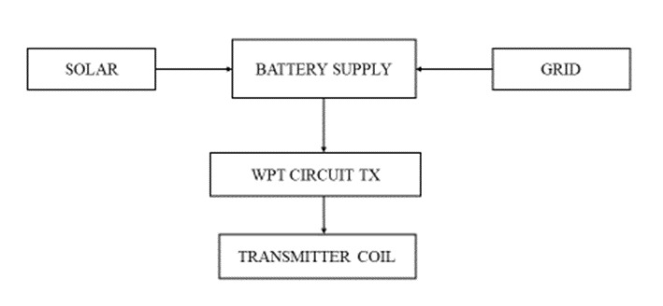
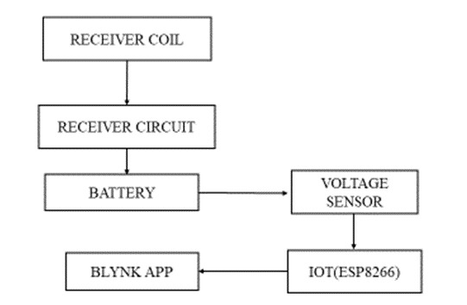
Block Diagram / Circuit Diagram

Slide 8
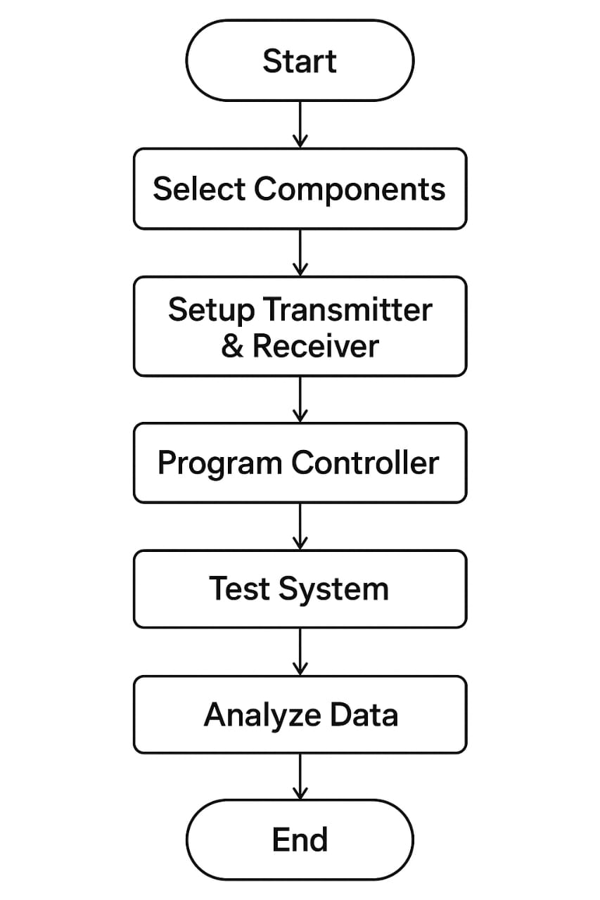
Methodology / Flowchart
Select hardware (transmitter & receiver coils) and software (Blynk app).
Set up dual source wireless transmitters and receiver circuits.
Program microcontroller for power control and app communication.
Test system for efficiency and alignment.
Collect and analyze charging data.
Optimize and evaluate performance.

Slide 9
Hardware & Software Used
Hardware Used
Solar panel
Grid power supply
Power converter
Transmitter & receiver coils
Microcontroller (Arduino/ESP32)
BMS and battery
Rectifier & switching components
Software Used
Blynk App (IoT monitoring)
Arduino IDE (programming)

Slide 10
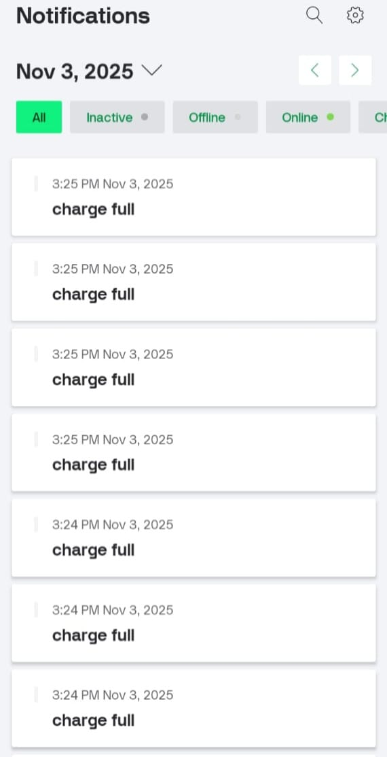

Simulation Results

Slide 11
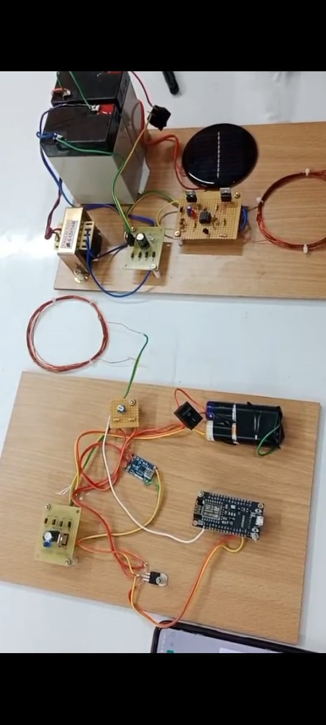
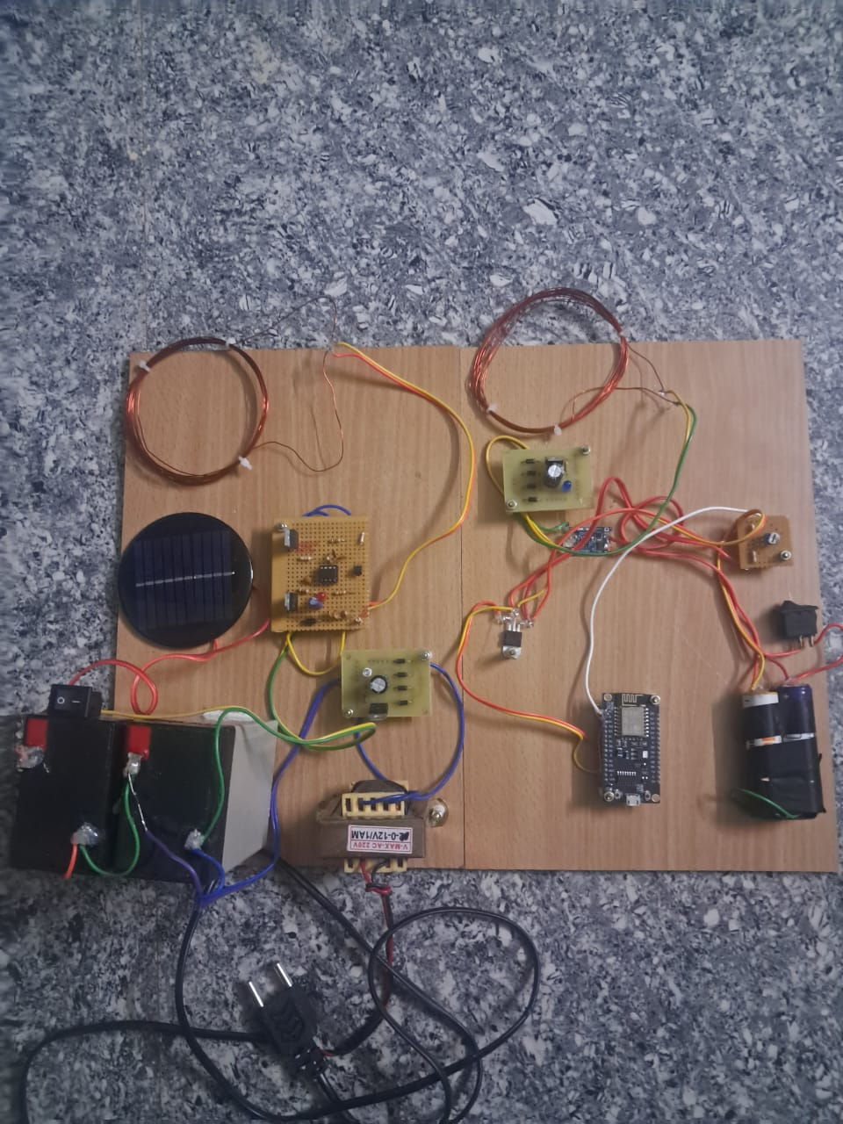
Hardware Prototype

Slide 12
Results & Discussion
The dual-source system successfully charged the EV battery using both solar and grid power.
Automatic source switching worked smoothly when solar power was low.
Wireless charging through inductive coils was stable with consistent power transfer.
Blynk App monitoring showed real-time charging status, voltage, and source selection.
Overall, the system proved efficient, reliable, and suitable for continuous EV charging.

Slide 13
Applications
Wireless charging for electric cars, bikes, and scooters.
Charging in parking lots, homes, and public stations.
Dynamic charging on roads for slow-moving EVs.
Smart charging systems with IoT monitoring (Blynk app).

Slide 14
Advantages & Limitations
Advantages
Provides continuous charging using dual sources (solar + grid).
Fully wireless, safe, and convenient for users.
Reduces dependency on grid power using renewable energy.
Low maintenance and supports IoT monitoring through Blynk.
Limitations
Efficiency decreases with coil misalignment.
Solar power is weather-dependent.
Limited charging distance; requires close coil positioning.
Initial setup cost can be high.

Slide 15
Project Outcome
The project will be published in the IEEE platform, and a project report will be prepared

Slide 16
Future Scope
Implement fast wireless charging with higher efficiency.
Develop dynamic charging roads for moving EVs.
Integrate battery health prediction using AI/ML.
Expand IoT features for remote control and analytics.
Use advanced coil designs to reduce misalignment losses.

Slide 17
Conclusion
The dual-source wireless charging system proves to be an effective solution for electric vehicle charging. By combining solar energy with grid power, the system ensures continuous and reliable charging at all times. The wireless inductive method makes the process safe, simple, and convenient for users. With features like automatic source switching and Blynk-based monitoring, the system becomes more efficient and user-friendly. Overall, this project demonstrates a practical and eco-friendly approach that can support the growing demand for electric vehicles in the future.

Slide 18
Reference
P. Swarnkar, N. Prajapati, I. Brar, and D. Dewangan, “Wireless Power Transfer Electric Vehicle Charger Using Solar Energy,” Proceedings of IEEE ICEPES, June 2024.
R. Sharma and A. Verma, “Design of Dynamic Wireless Charging System for Electric Vehicles Using Solar PV,” Proceedings of IEEE ICPEICES, December 2024.
M. Khan, S. Ali, and F. Ahmed, “Solar Powered Inductive Charging for Moving Electric Vehicles,” Proceedings of IEEE ICETAS, November 2024.
X. Liu and S. Chau, “Energy Management and Control in Hybrid Solar–Grid EV Charging Systems,” IEEE Transactions on Transportation Electrification, 2023.
Y. Zhang, L. Wang, and H. Lee, “Design and Analysis of Resonant Inductive Coupling for Dynamic Wireless EV Charging,” IEEE Access Journal, 2023.

